Slide 1



POWER OF STORY TELLING
+

Slide 2

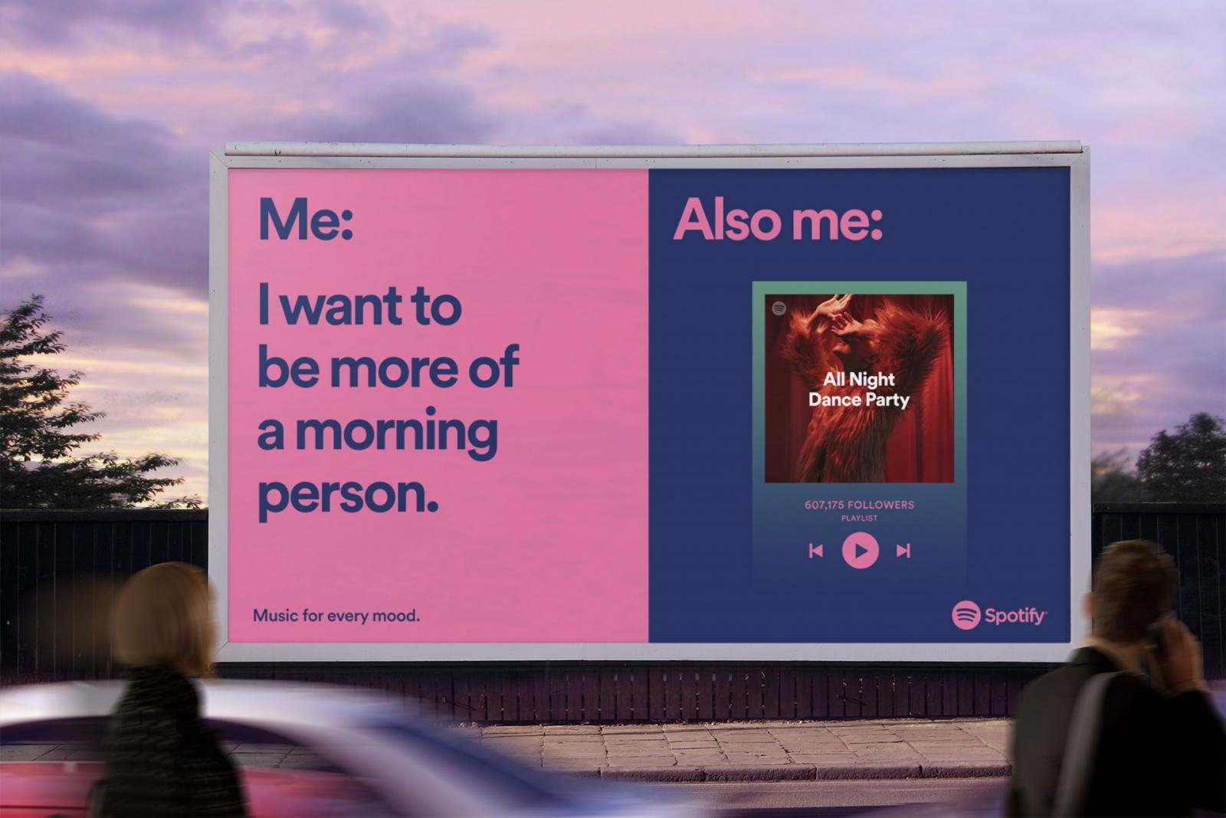

WHAT IS STORY TELLING?
Using a narrative to tell a message
Stories leave an impact
Why tell a story?
WE ARE A CREATIVE AGENCY.

Slide 3

1. ESTABLISH A THEME
Sample themes:
  Overcome conflict
  Testimonial
  History or ‘how it started”
  Aspirations
  Discovery and beyond!

Slide 4
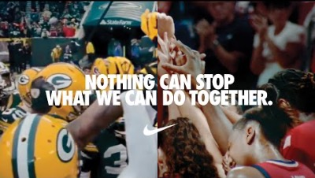

Slide 5
NIKE: YOU CAN’T STOP US
Themes:
  Loss and redemption
  Teamwork
  Dedication
WE ARE A CREATIVE AGENCY.

Slide 6



2. BUILD YOUR STORY
Determine your medium
Consider VR/AR, social, text, etc.
Web experiences/sites/apps
Write a draft — share it!

Slide 7
3. MAKE YOUR STORY
Use of music and audio
Cinematic approaches
  Lighting
  Pacing/editing
  Lenses
Duration
WE ARE A CREATIVE AGENCY.

Slide 8


Slide 9
PAC
Themes:
  Hard work – sweat!
  Process
Executions:
  Use of music without narration
  Powerful imagery of athletes
  Dramatic lighting
  Flashy editing techniques
WE ARE A CREATIVE AGENCY.

Slide 11
VISIT TRI-CITIES
Themes:
  Discovery
Executions:
  Use of sound effects!
  Typography treatments
  Shot variety/cinematic approach
WE ARE A CREATIVE AGENCY.

Slide 12


Slide 13
TERRA BLANCA
Themes:
  History/process
Executions:
  Narration, power of words
  Shot variety
  Outdoor lighting (morning, evening, etc.)
WE ARE A CREATIVE AGENCY.

Slide 14

4. SHARE YOUR STORY
Where to find your audience?
  TV and/or Radio?
  Digital video advertising?

Slide 15


CONCLUSION:
Why tell a story?
Start with a theme
Consider executions
Make it happen!
Share your story

Slide 16
THANK YOU
+
CHECK OUT OUR WORK AT FOCALPOINTMARKETING.COM
AND ROLLANDCAP.COM

